Slide 1
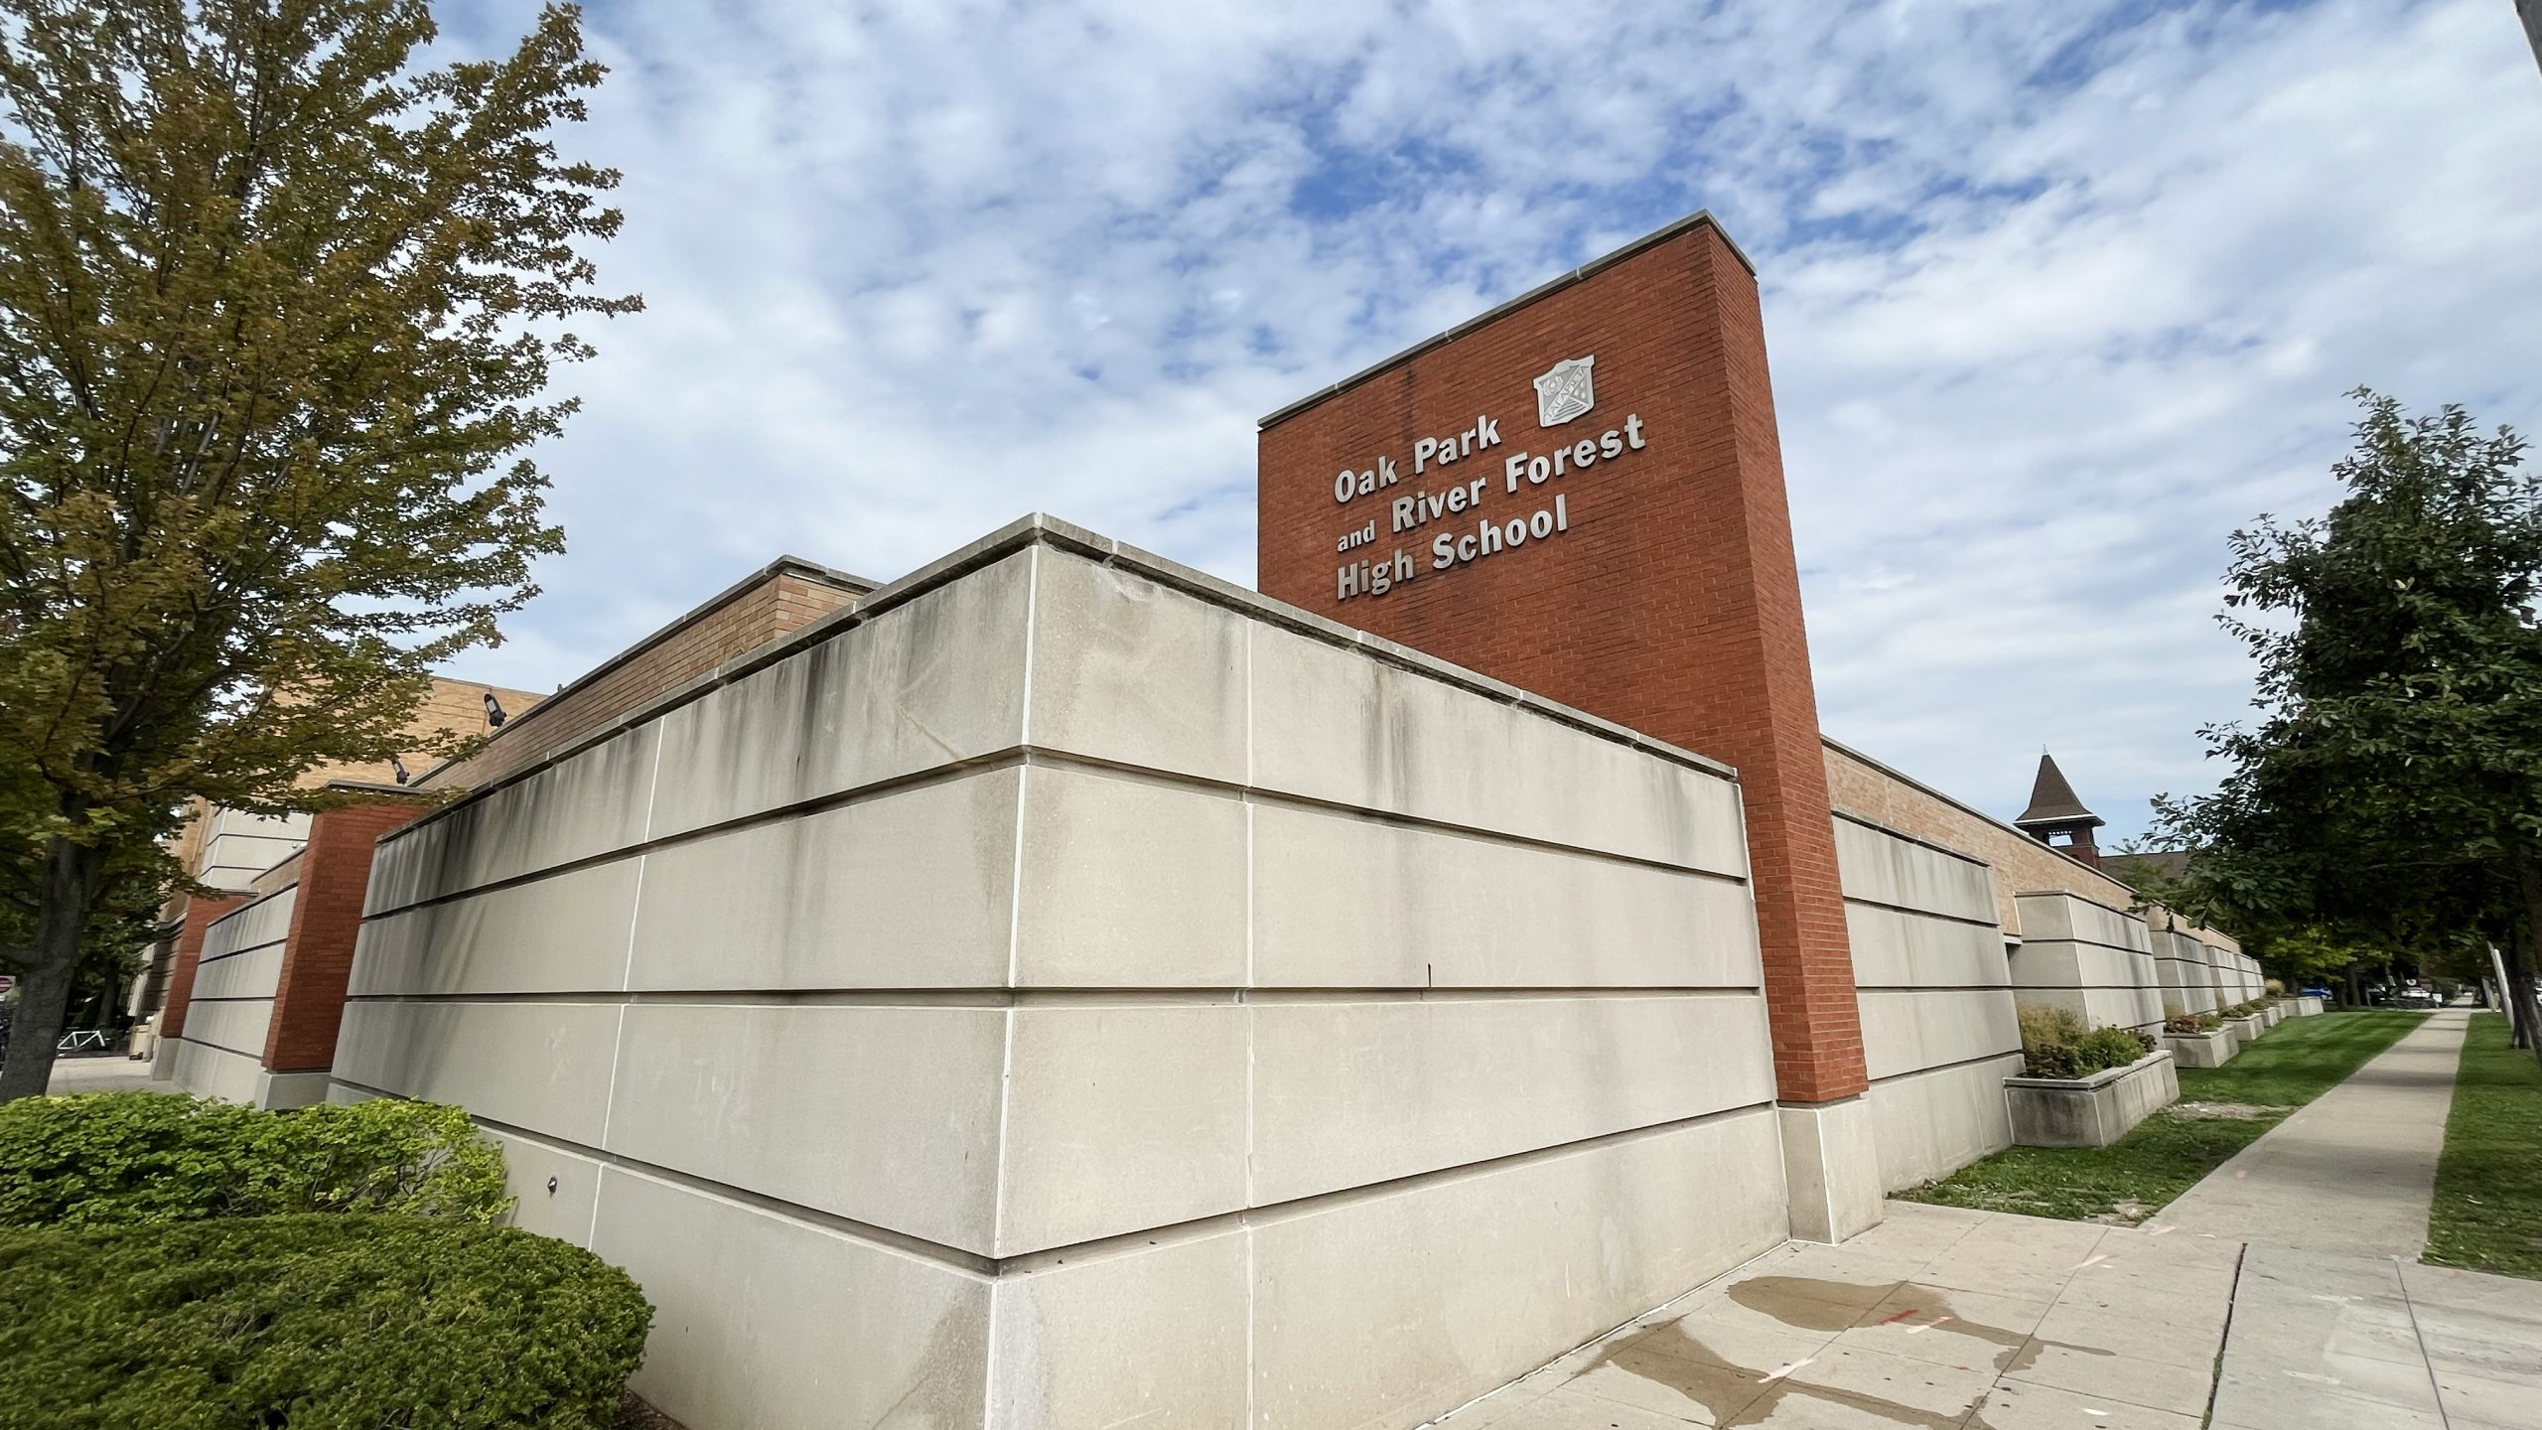
In Loving Memory of Our Classmates
OPRFHS Class of 1994 - Forever in Our Hearts

Slide 2
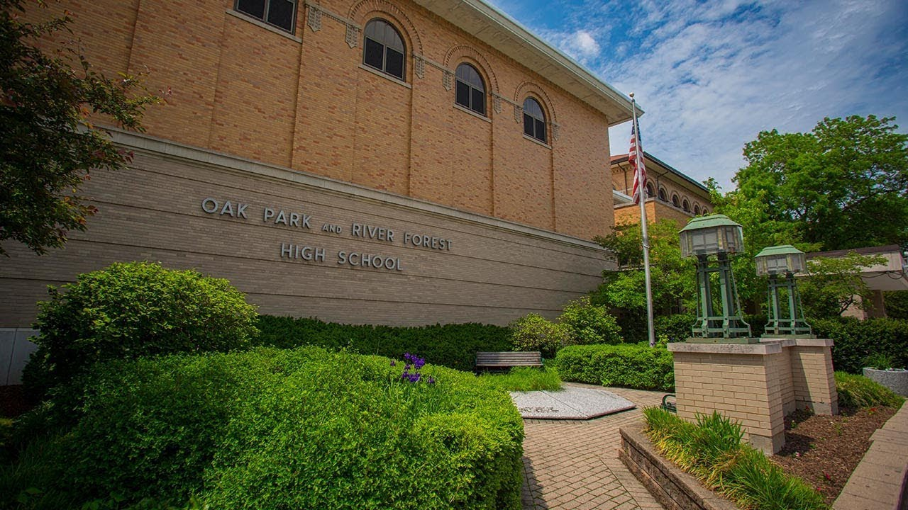
Remembering Their Legacy
Each of these individuals was a special part of our journey, creating memories and shaping our lives.
Today, we also celebrate the
joy they brought to us all.

Slide 3
Nicholas
Allabastro

Slide 4
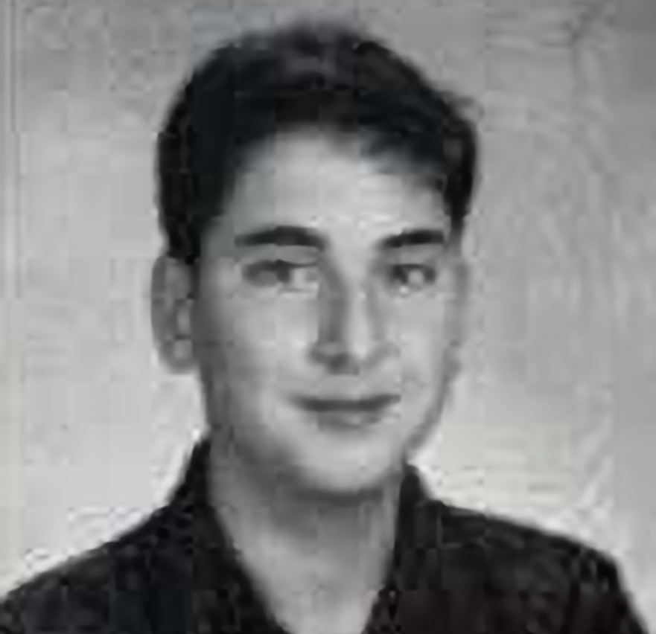
David
Amani

Slide 5
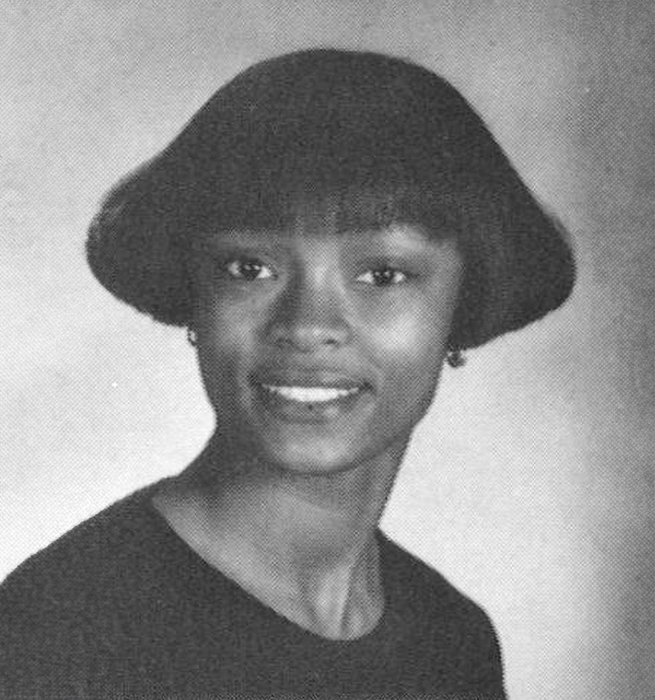
Diana
Bland

Slide 6
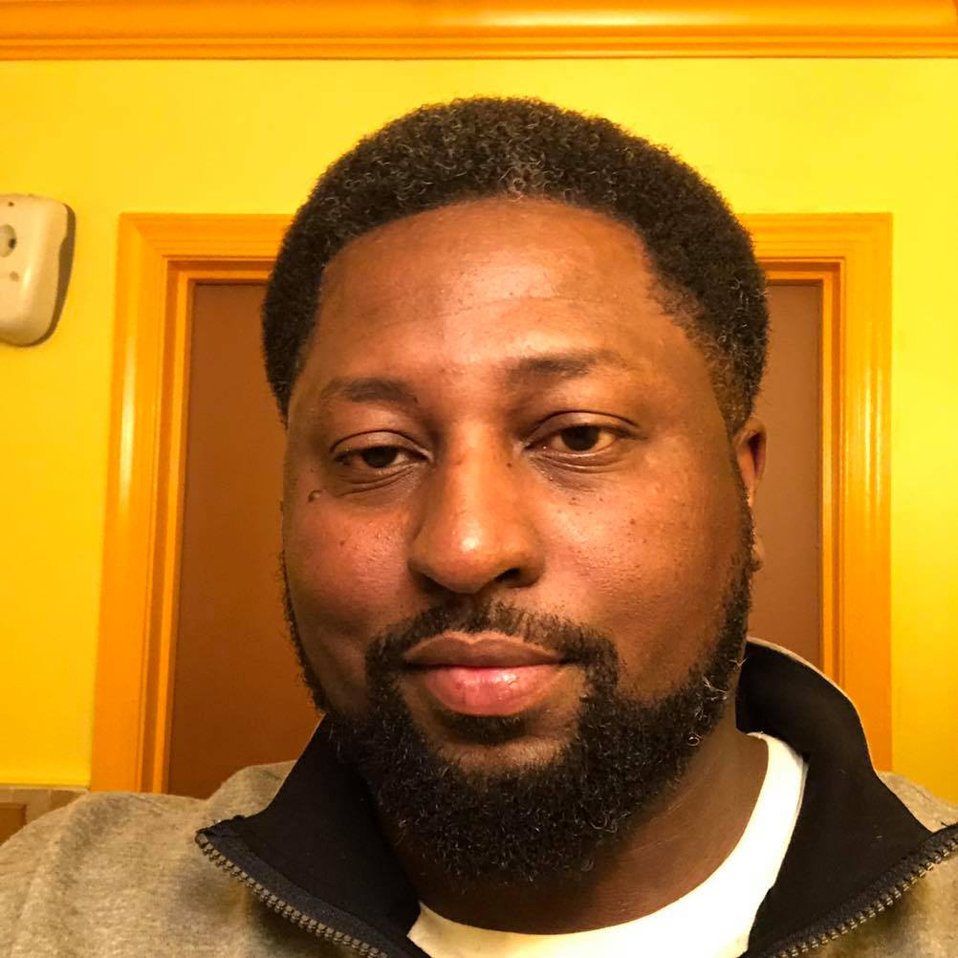
Chris
Brown

Slide 7
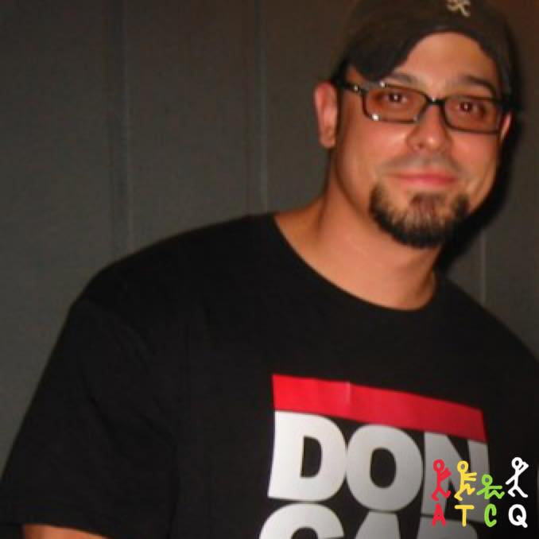
Brett
Cabanas

Slide 8
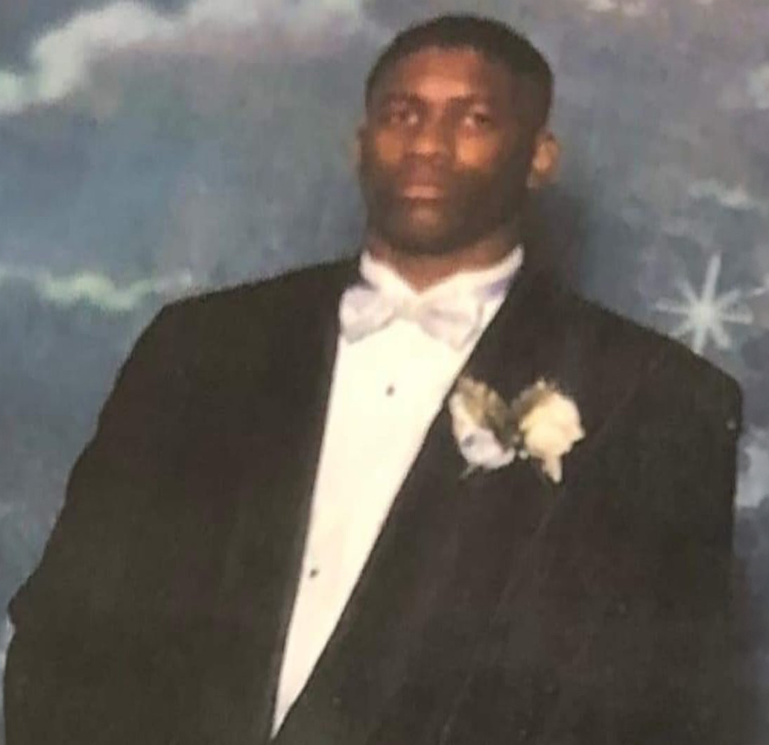
Joshua
Cheeks

Slide 9
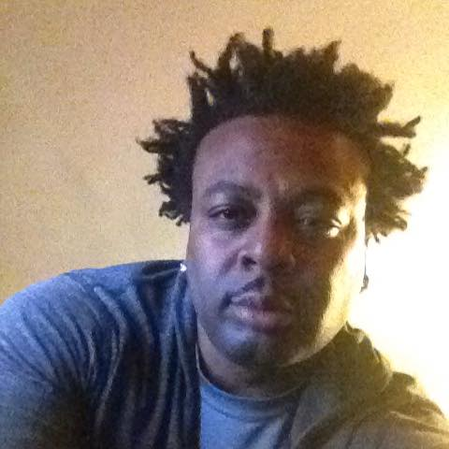
Julian
Clark

Slide 10
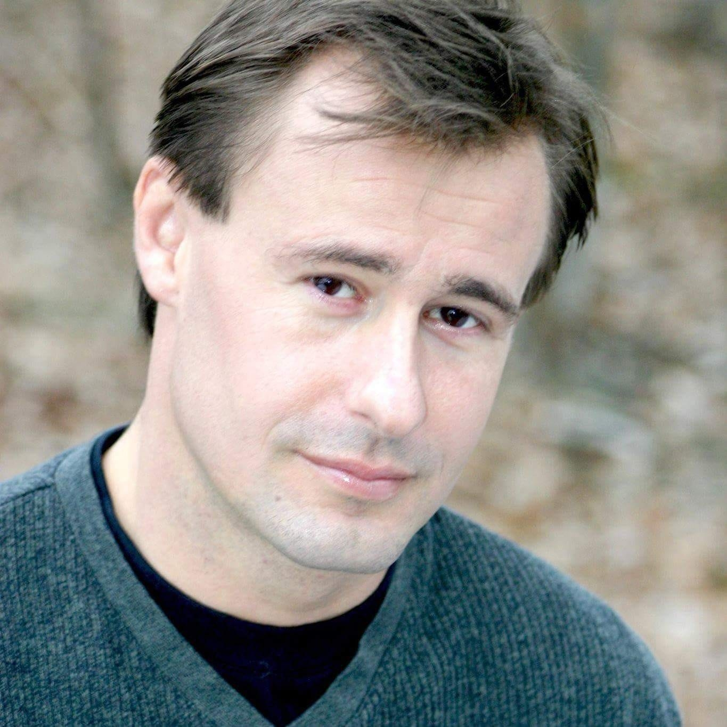
David
Eckberg

Slide 11
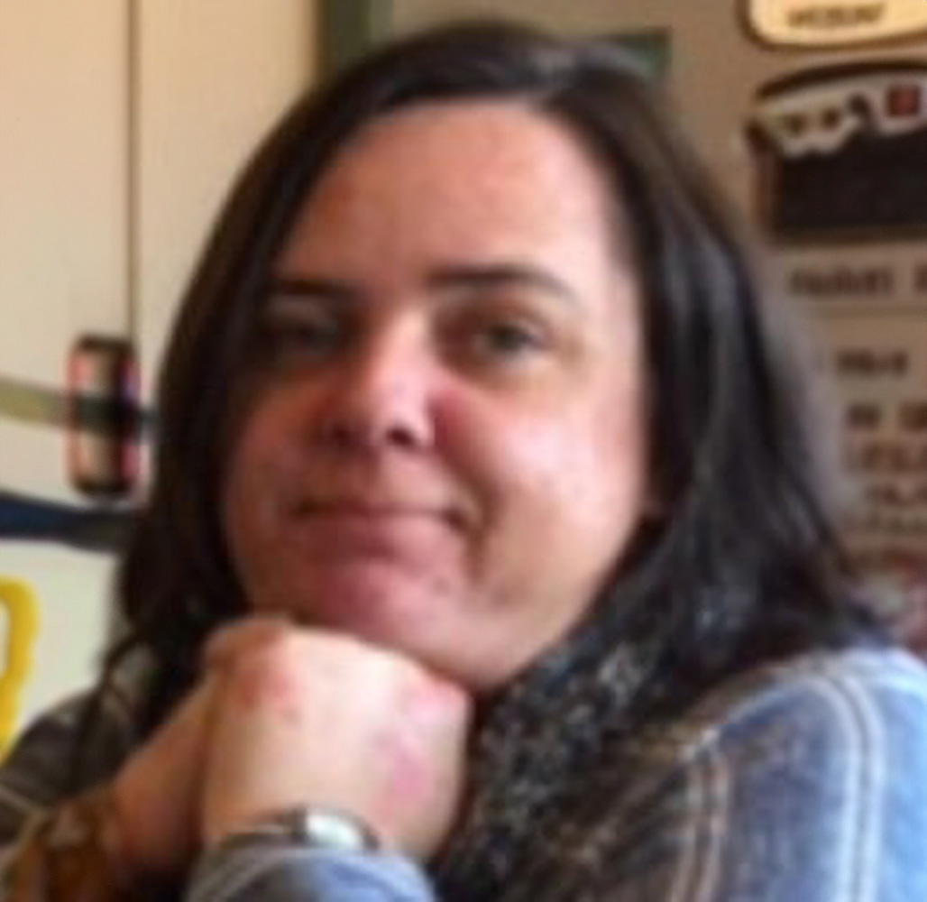
Kelly
Fogg

Slide 12
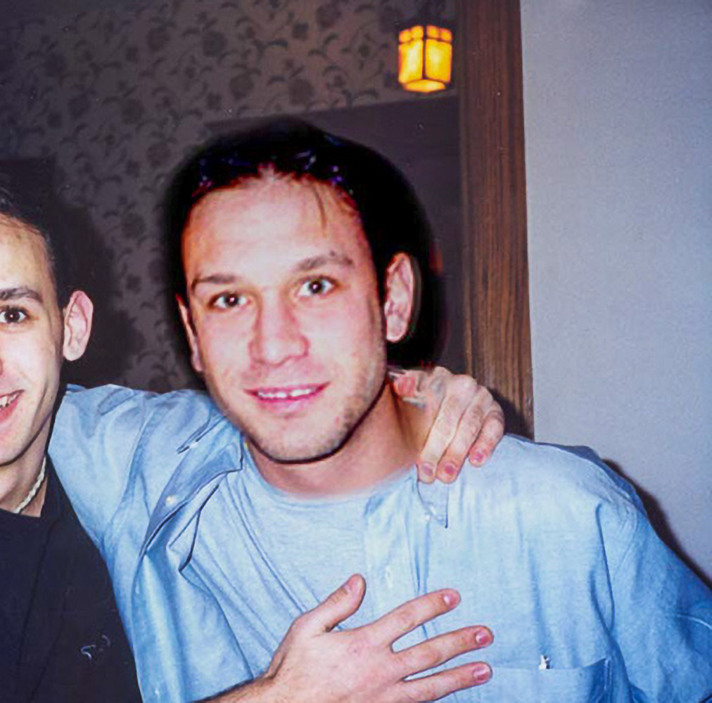
Andrew
Ghertner

Slide 13
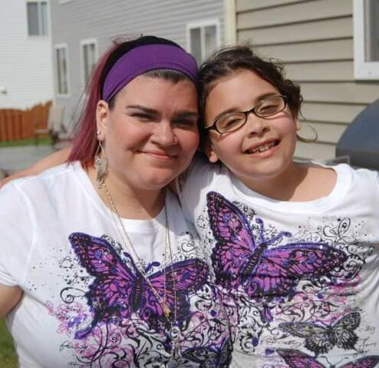
Angelina Goneno-Griffith

Slide 14
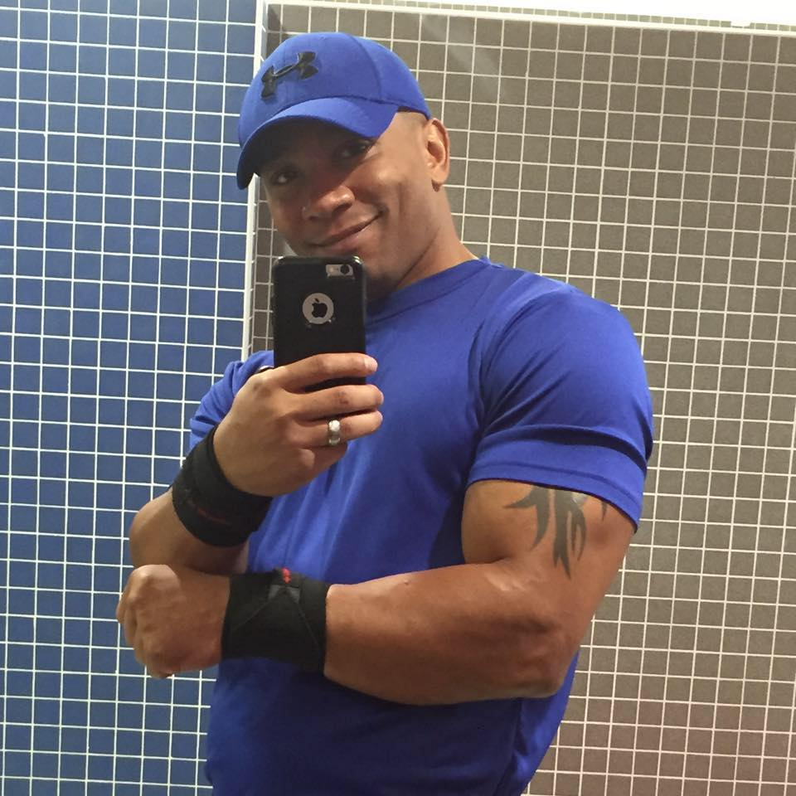
Julian
Gonzalez

Slide 15
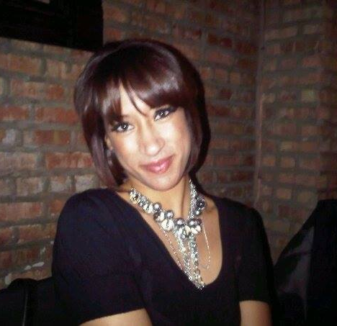
Jenni
Green

Slide 16
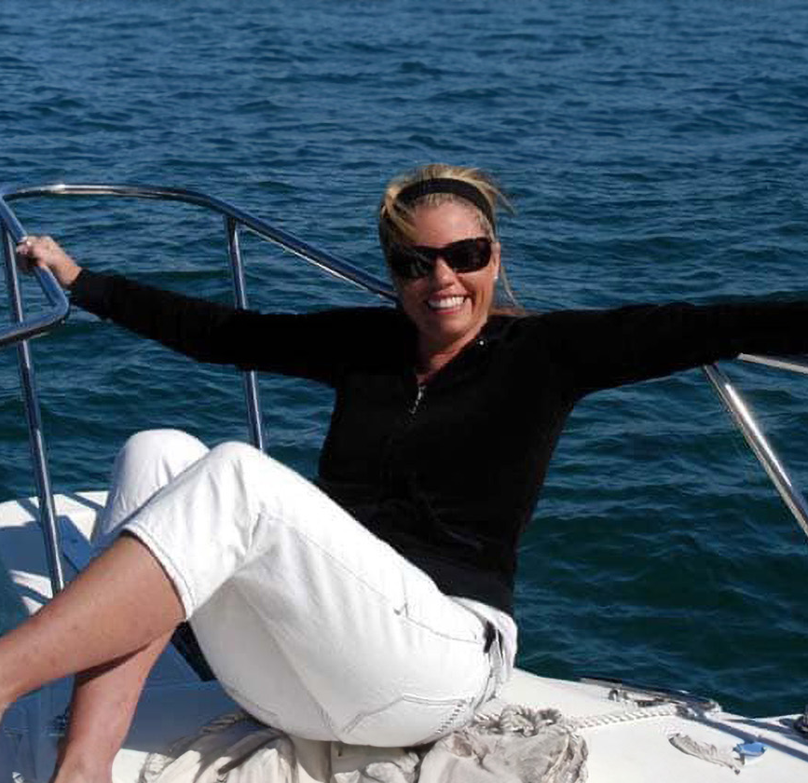
Charlotte
Harrison

Slide 17
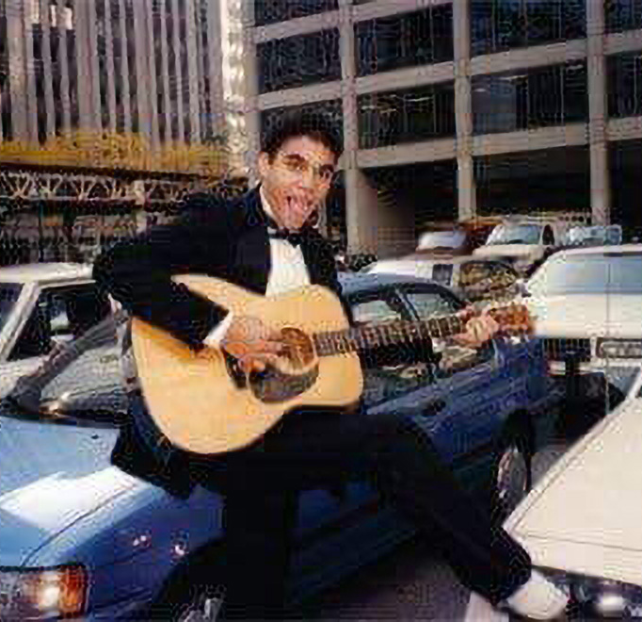
Brendan
Hedges

Slide 18
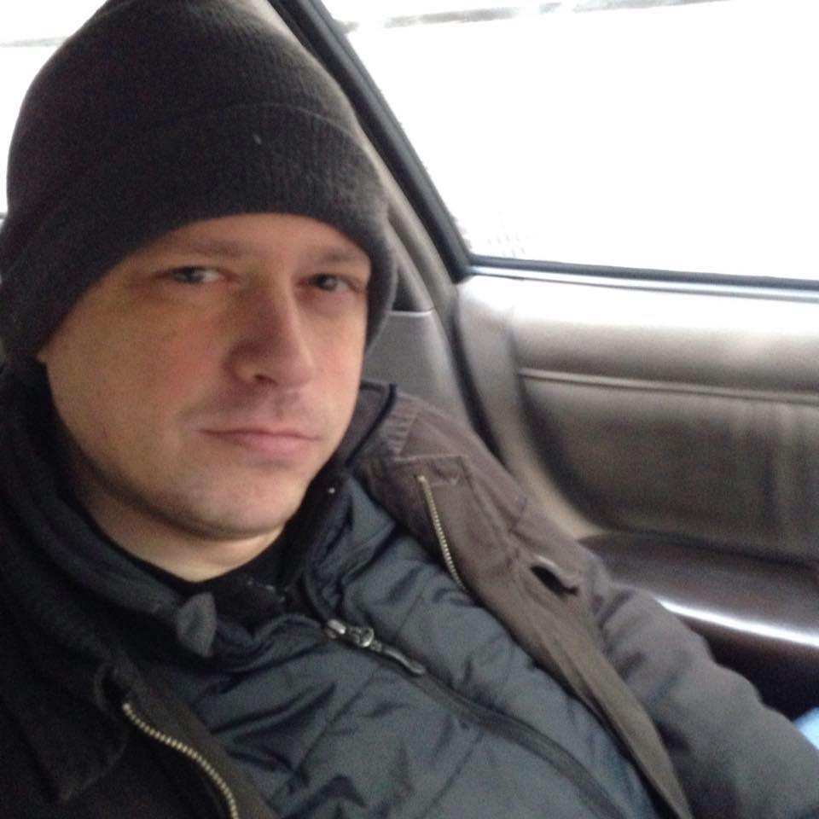
Langdon
Hutchinson

Slide 19
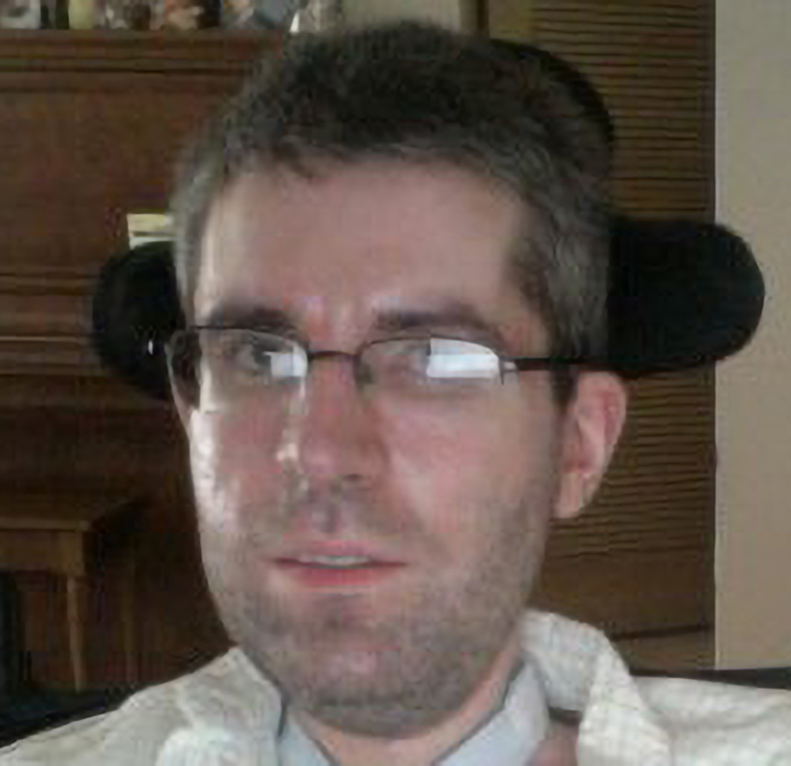
David
Hyde

Slide 20
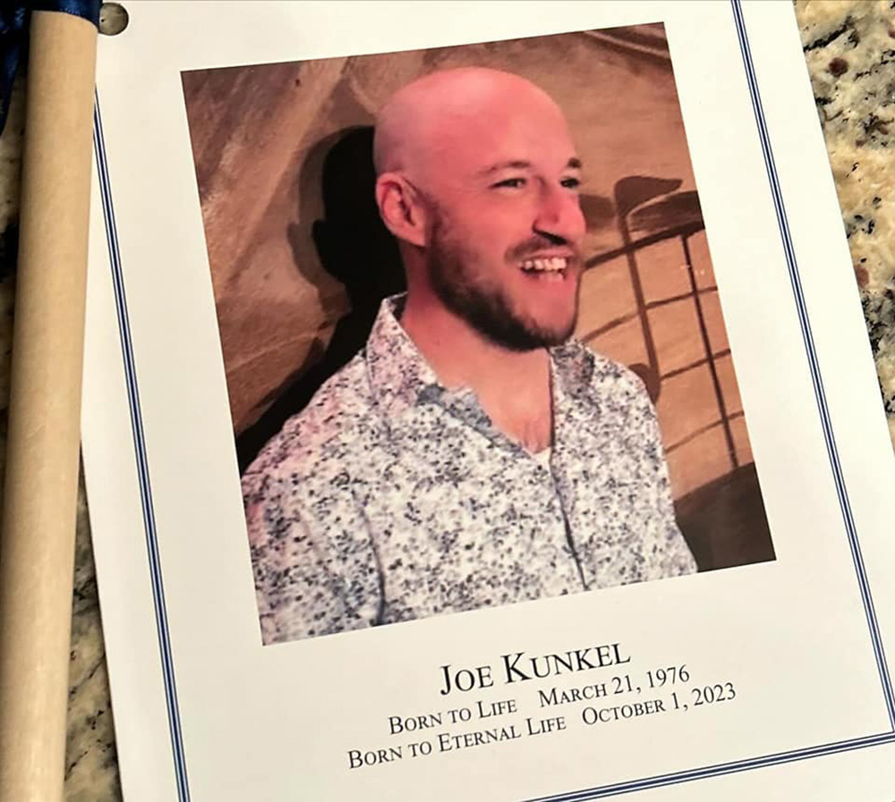
Joe
Kunkel

Slide 21
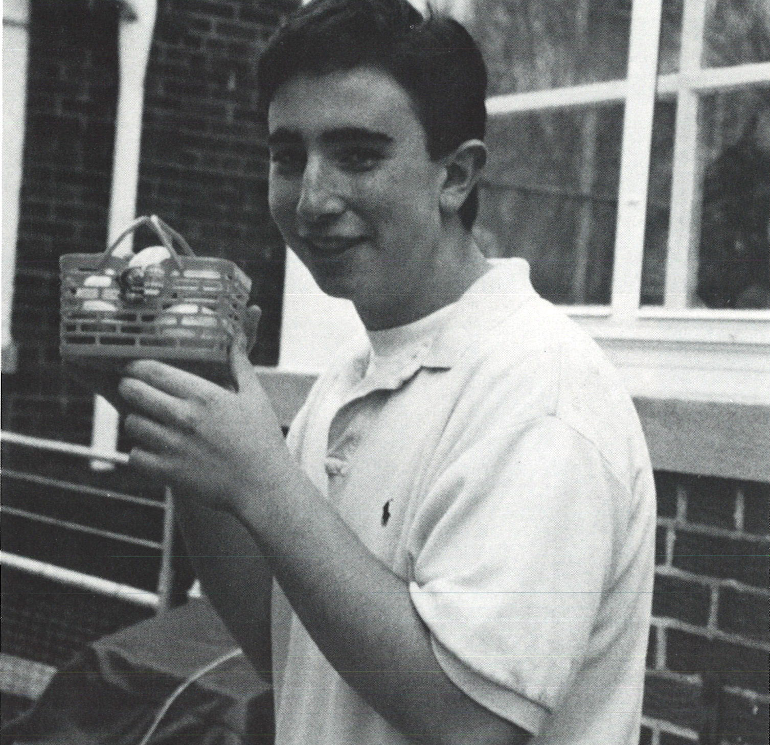
Timothy
Lutz

Slide 22
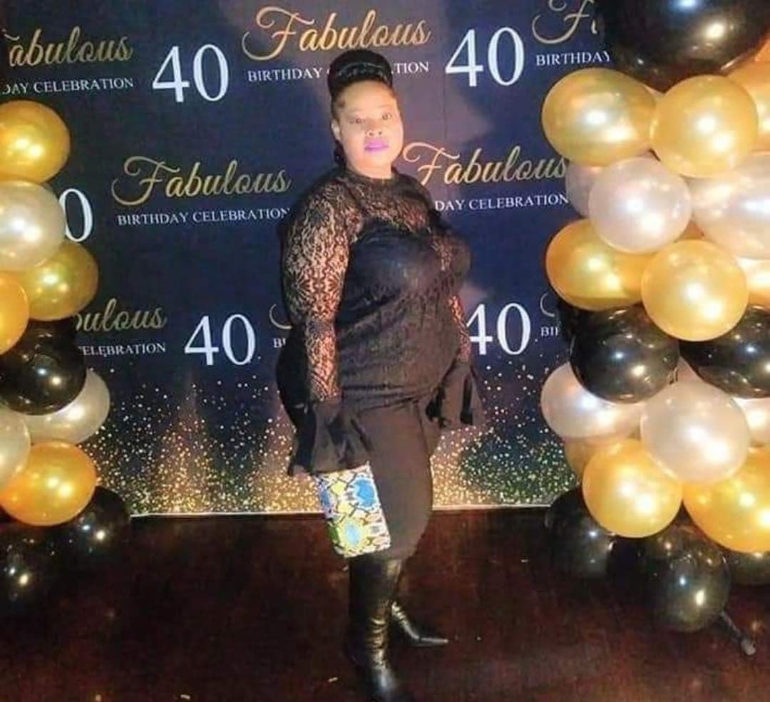
Janielle
Marcus

Slide 23
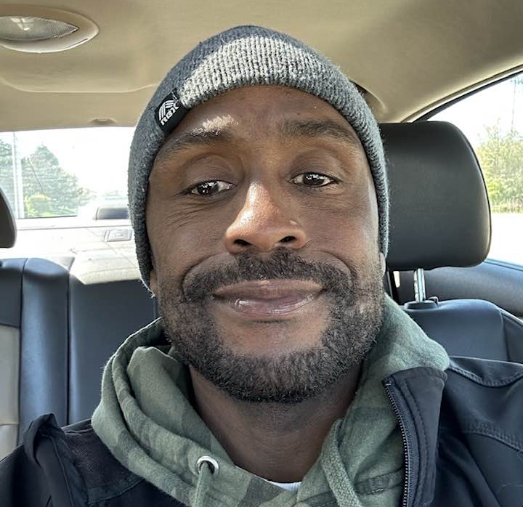
Jeams
Potts

Slide 24
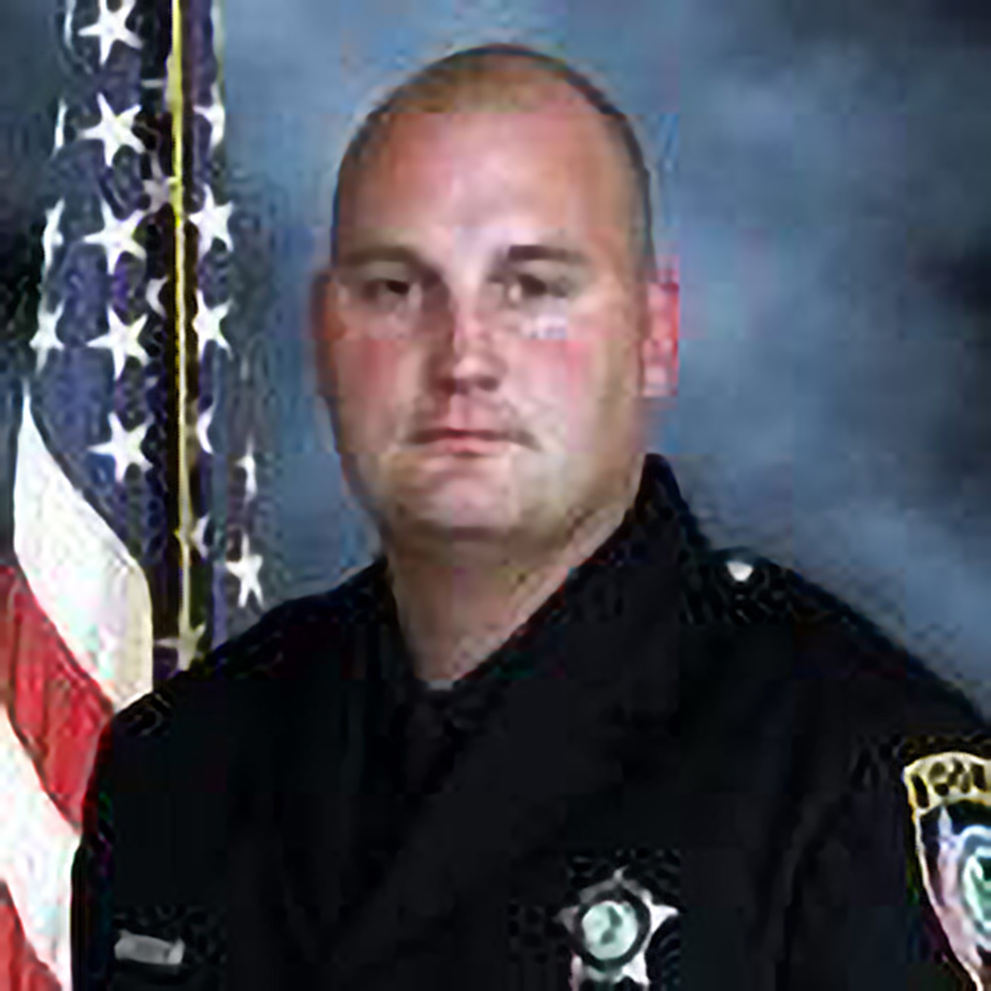
Thomas
Reilly

Slide 25
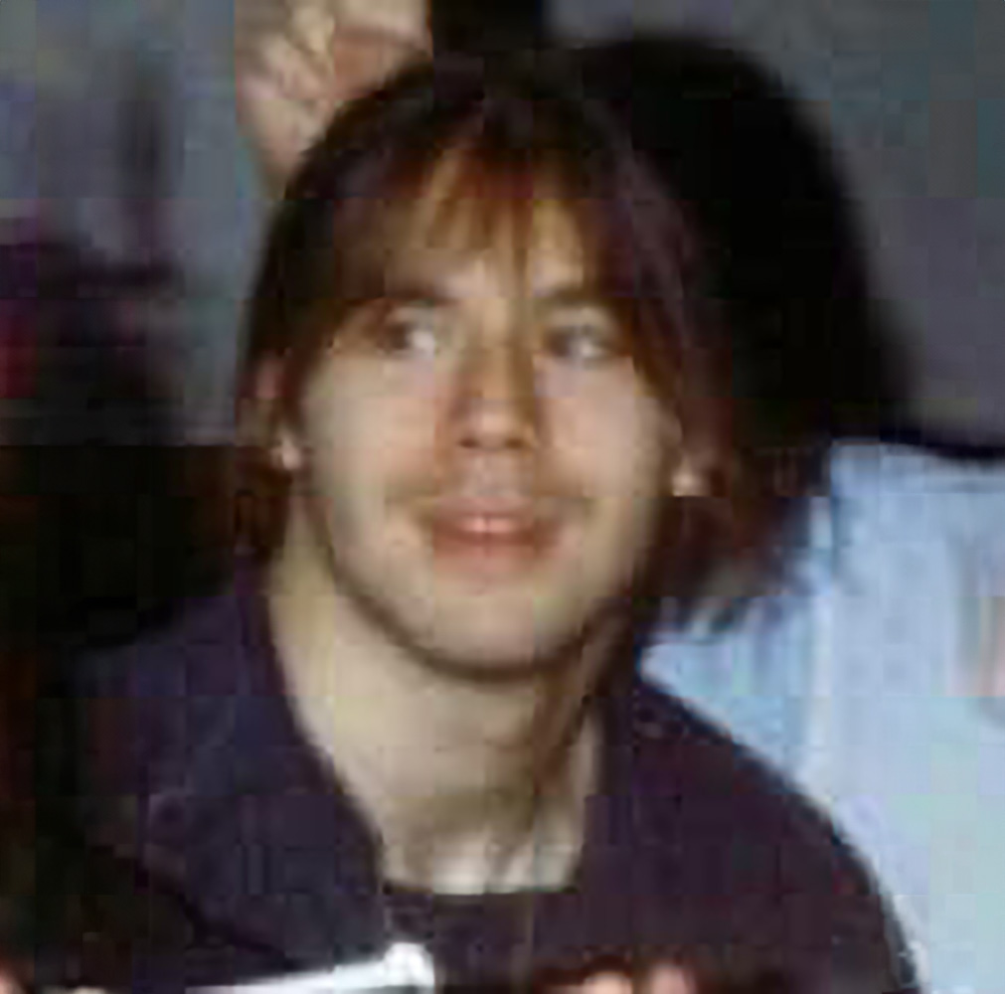
Markian
Reynarowych

Slide 26
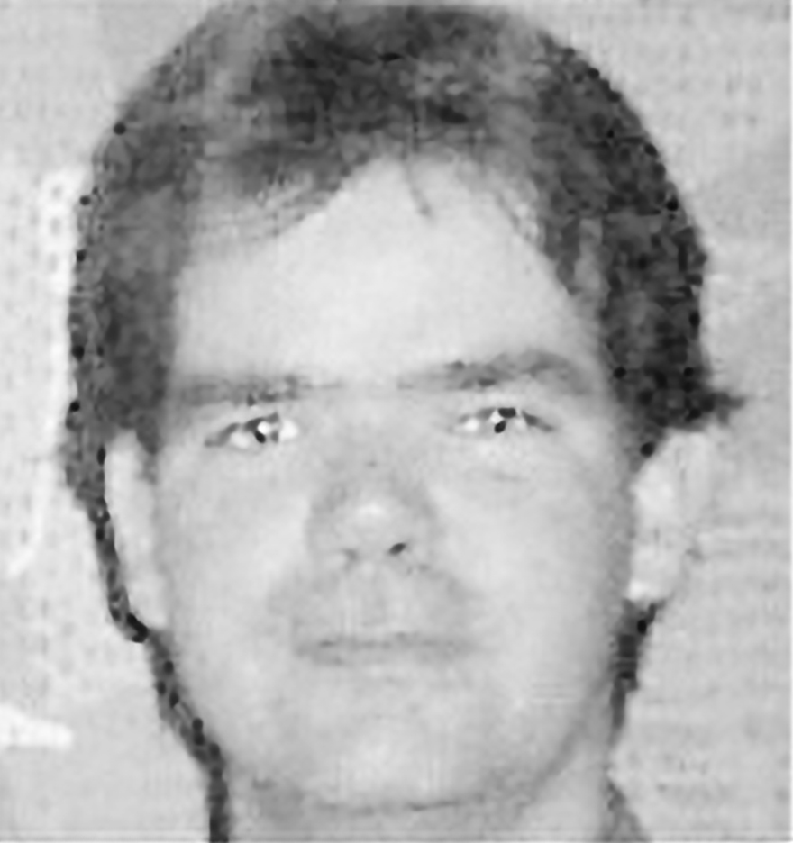
Larry
Rossow

Slide 27
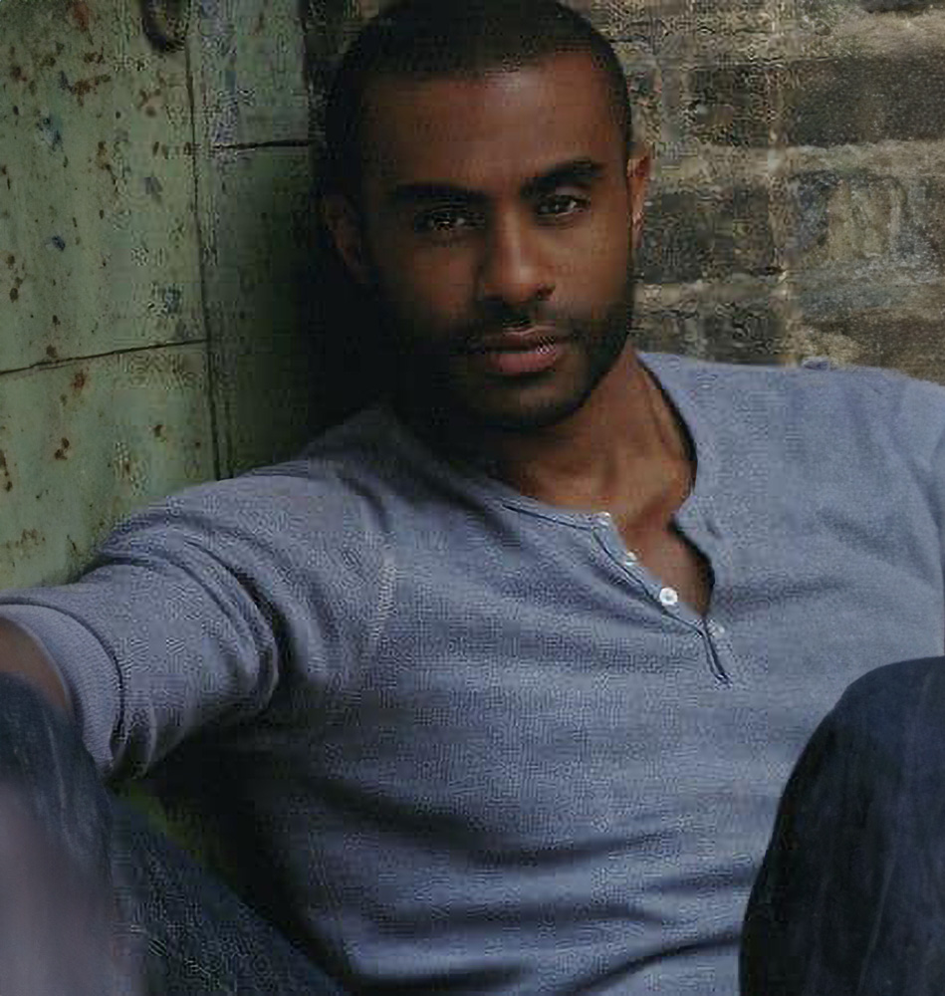
Marcus
Smith

Slide 28
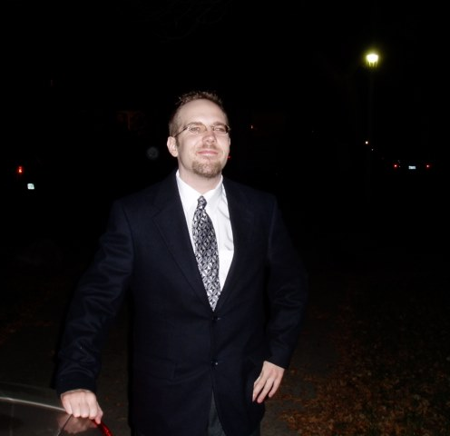
Kevin
Tideman

Slide 29
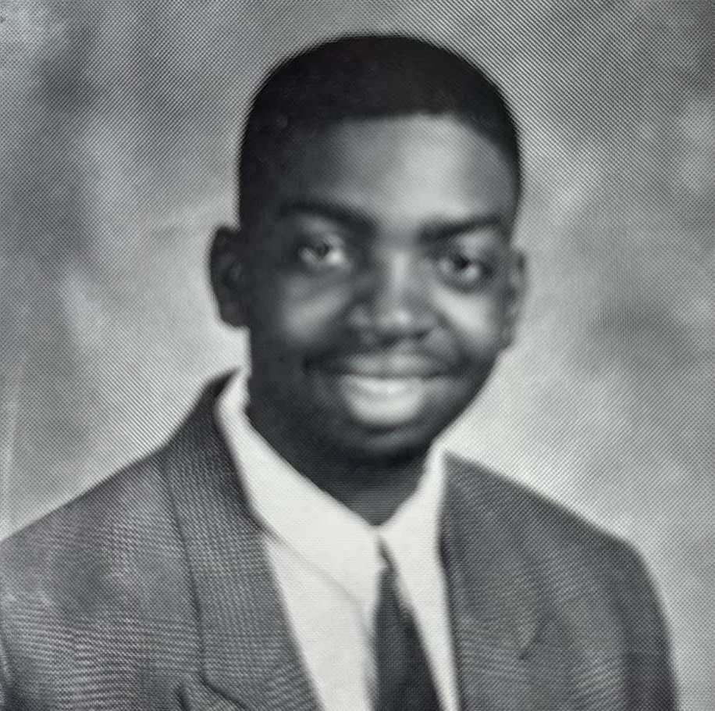
Kacy
Towner

Slide 30
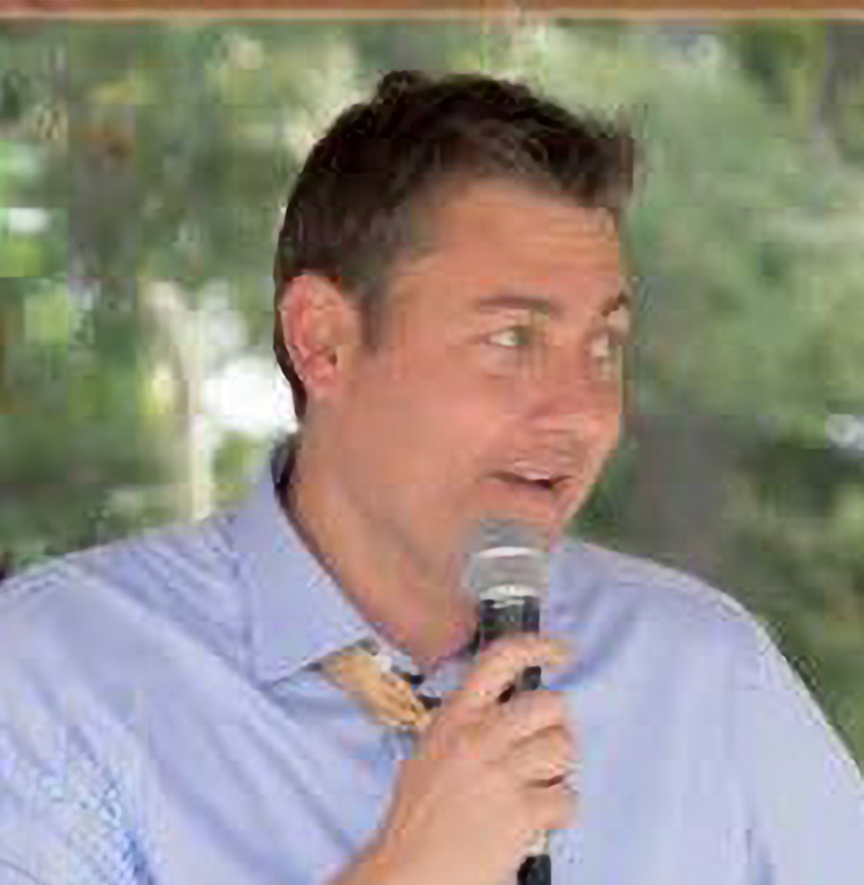
Patrick
Vizzone

Slide 31
Always in Hearts

